Slide 1
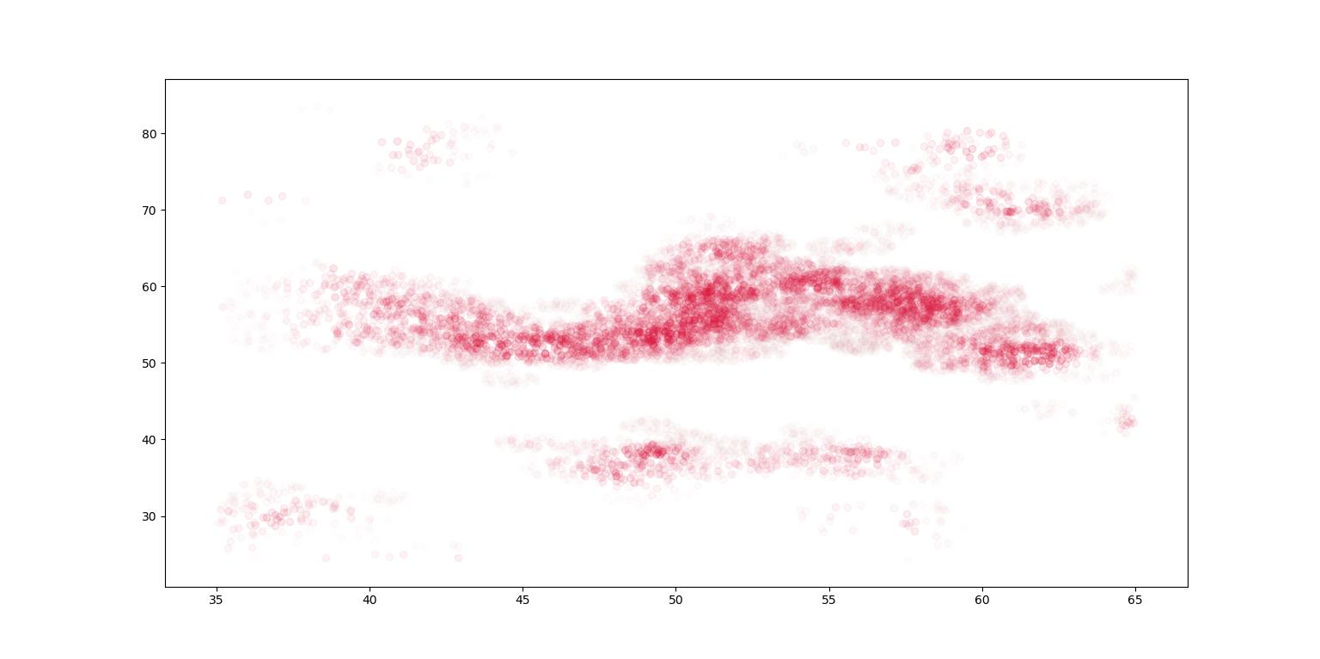
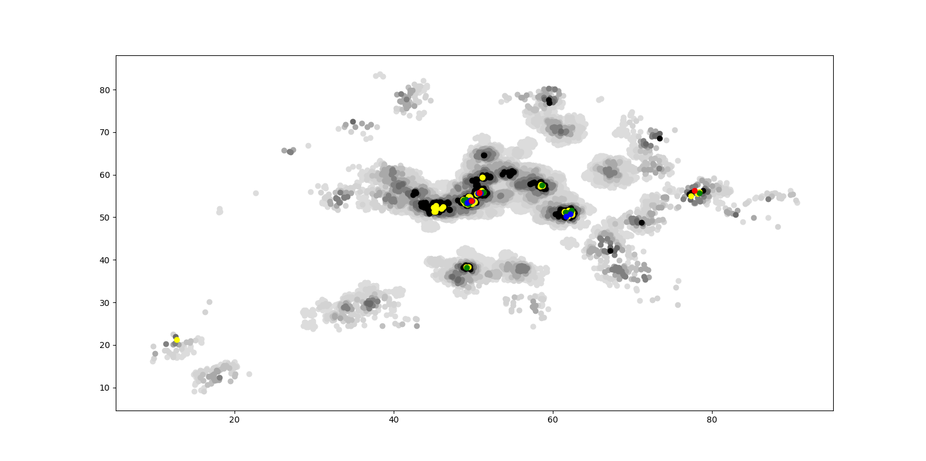
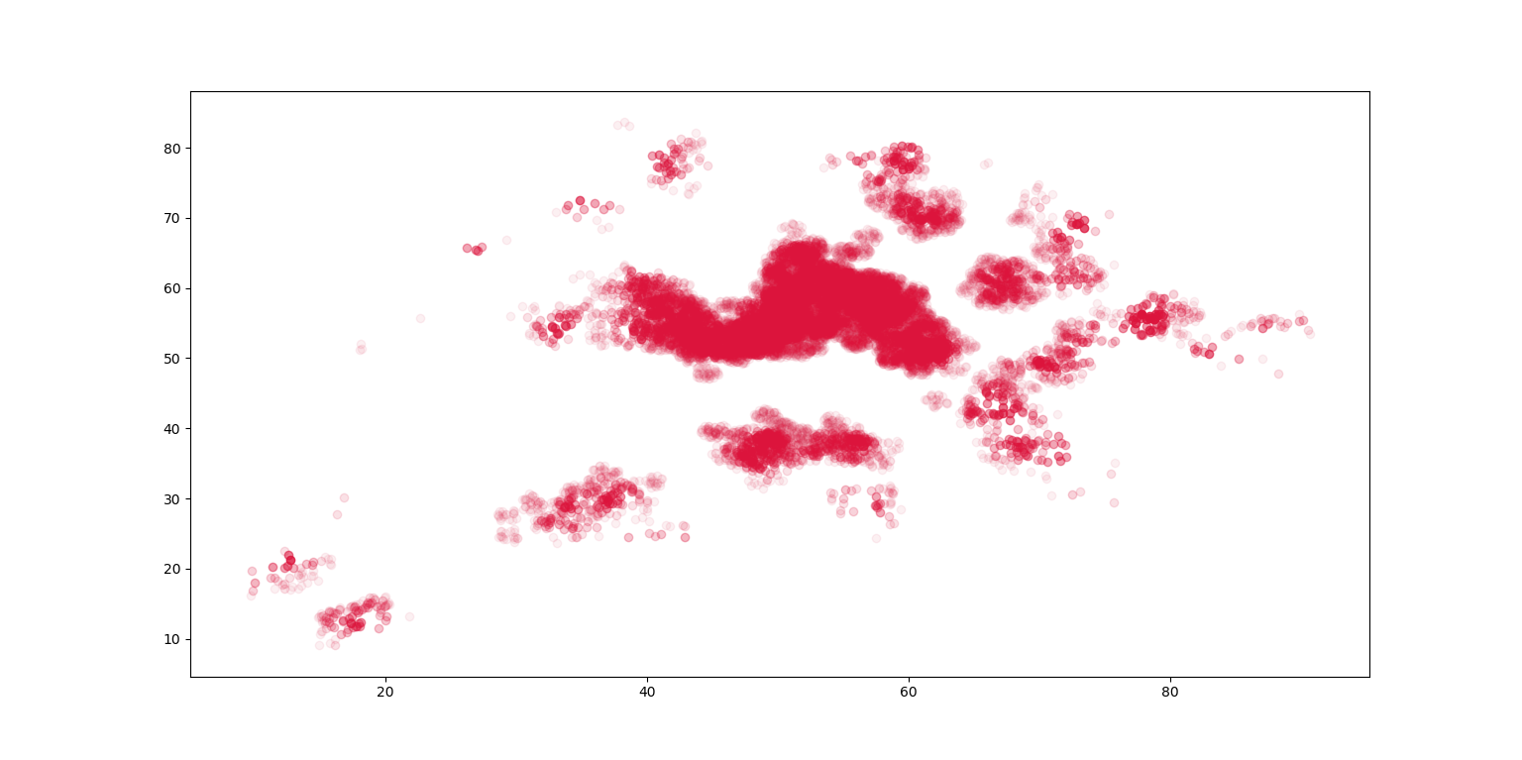
VE414 • Bayesian Analysis
VE414 Project：
Finding Trees in Forbidden Forest Using Hidden Markov Model
Team Members: Wenhao Guo, Jiazhen Ji, Jing Dong
Faculty Advisor: Prof. Jing Liu
Problem Statement
Graphs
To help us observe data provided, we utilize python to plot graphs which are able to show density of Tayes. In Figure 1, we plot every point where Tayes exits in a circle with radius of 1 m. Different colors represent different number of Tayes. And color representing a greater number of Tayes will cover color representing a smaller number of Tayes.
Fig. 1 Density of Tayes
Another graph uses transparency to express the number of Tayes near a point. As we can see in Figure 2, because of too many Tayes are founded in the center of graph, it is not clear for us to observe it. So we plot another graph to focus on the center part.
Fig. 2 Density of Tayes
Fig. 3 Center Part
Method 1: HMM
The design uses two step motors to move the phantom in XY plane. Three mirrors lead
Method 2: Logistic Regression
Valid
Conclusion
Photoacoustic and ultrasound imaging techniques can be used for detecting osseous and vascular structures simultaneously. The key to achieve this goal is to set up the dual modality system. And also, the accuracy and speed of the detection is very important to form the images.
Acknowledgement
Sponsor: Shawn Ma from Covidien
Shane Johnson, Sung-Liang Chen and Huan Qi from UM-SJTU Joint Institute
Hongkun Lai and Xunjie Cai from UM-SJTU Joint Institute
Reference
[1]http://labs.seas.wustl.edu/bme/Wang/index.html

